Slide 1
Health Homie
Your personal pocket helper.
Built with passion by:
-Cristea Octavian
-Cujba Daniel
-Dumitrana Mihnea

Slide 2
Quick Presentation Summary
01
02
03
04
05
Why?
Built in?
How?
Because you may need it more than you think
Flutter – offering a ‘wonderful’ cross platform development experience
With excruciating pain
(more in the app showcase)
Structure?
Conclusion & Key Takeaways
The application is based on a 3-option menu
With a minimalist look
Pretty self explanatory

Slide 3
01
Why bother?

Slide 4
OUR MAIN MISSION
01 Why?
The target of our app is to help as many people as we can, even if that means just a small bump in the right direction.

Slide 5
Because it helps with:
01 Why?
Establishing safe boundaries
People who struggle with high phone usage or have a chaotic eating routine
Assuming responsability
Keeping track of your progress also means pushing yourself above yesterday’s standard
Taking care of your mental health
By limiting exposure to social media and other psyhically draining activities

Slide 6
02
Built in?

Slide 7
Our First Flutter Experience
So why did we choose Flutter?
Cross Platform Compatibility
Widely used in the industry
Google-provided documentation
And the most important thing: It was something new for each one of us
It sounded easier on paper

Slide 8
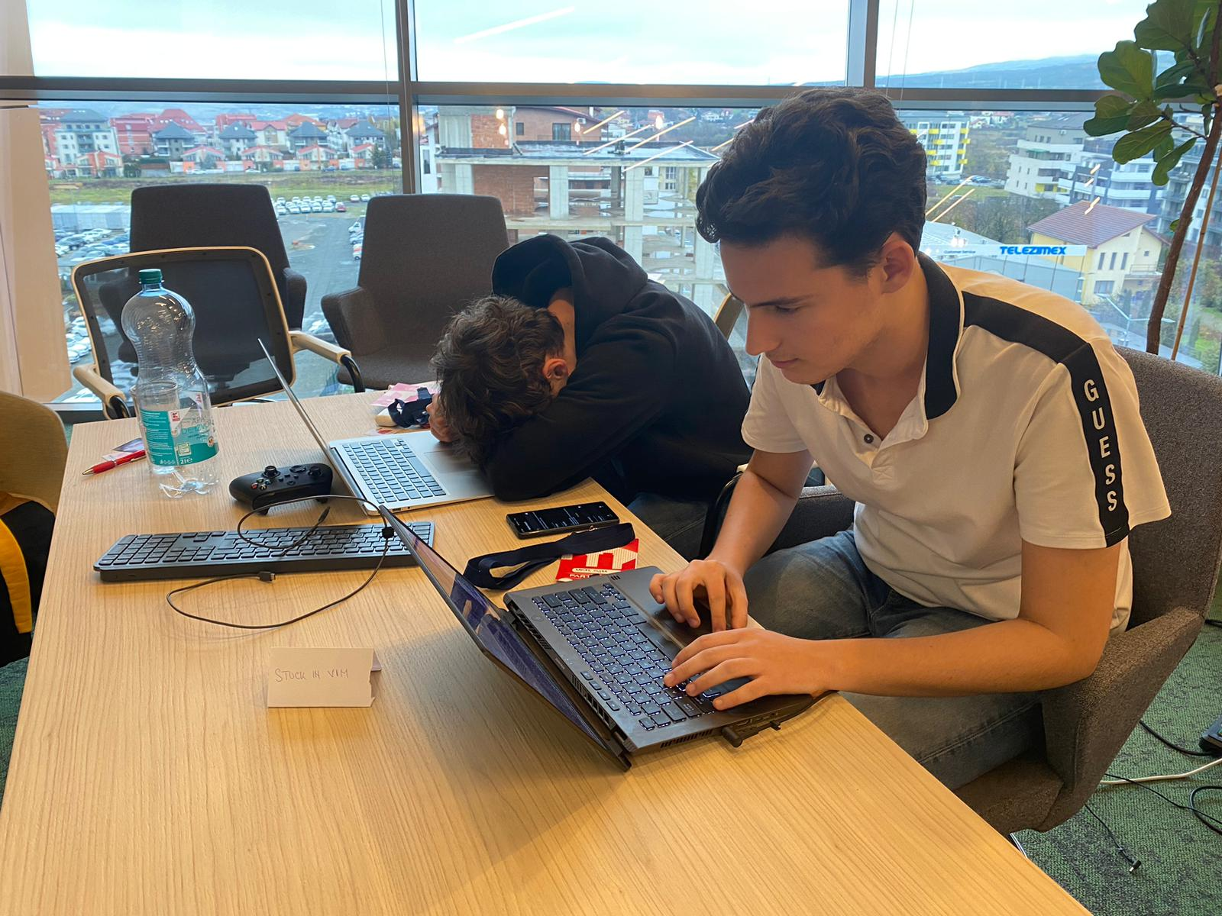
A PICTURE IS WORTH A THOUSAND WORDS

Slide 9
04
STRUCTURE?

Slide 10
OUR FEATURES
DIFFERENT TRACKERS
PROFILE PAGE
-Steps tracker
-Hydration tracker
-Phone usage
Showcasing personalised information about the user
DAILY TASKS
Keeps track of premade and custom tasks for the user

Slide 11
05
CONCLUSION & KEY TAKEAWAYS

Slide 12
Quick Summary
Mental and Physical health is a subject that nowadays doesn’t receive enough attention.
We often get lost in our day to day problems and forget to focus on ourselves.
Health Homie is meant to be a guide toward a better you but it cannot do that without your implication.
Thank you for your attention!

Slide 13
“There is no God when you’re looking for the missing comma…”
—SOMEONE FAMOUS

